Slide 1
Gathering Communities Through Recreational Esports
Andrew Madison | andrew@missioncontrol.gg

Slide 2
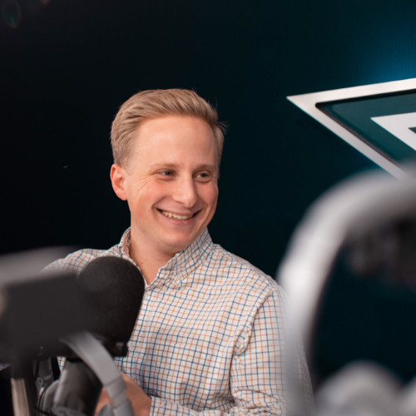
Mission Control Team
Daniel Herz
Chief Revenue Officer
daniel@missioncontrol.gg
Andrew Madison
Sales Manager
andrew@missioncontrol.gg
Byron Abrigg
Chief Customer Officer
byron@missioncontrol.gg
Notes:
Hi everyone! Welcome to Mission Control 101’s webinar… A few introductions and notes before we start.
First, the team. Daniel Herz, Maia Delkamiller and myself make up the sales and partnerships team at Mission Control. You’ve likely chatted with one of us before today, and our inboxes are open for ongoing support after the webinar, too. They are also here today and they’ll be monitoring the chat to answer and bring up questions during the webinar.
Speaking of the chat… a quick tour of the platform. To the right of my face is the general chat - we’d love for you let us know where you’re joining from! Throw your name and organization in there...
Below my face… this is where the questions go - NOT in the chat. Put any questions you have down there and we will answer them as we go, or in the Q&A at the end. You’ll also see our poll down there - we’d love to see feedback here to make sure we’re tailoring this conversation as well as we can - To start, It’s a simple question - what’s your experience with esports/gaming. We’ll put up another poll or two along the way as well, so keep your ears open.

Slide 3
TODAY’S WEBINAR
Esports 101
KRPA Overview
How to Get Started
Q&A
Notes:
For today’s demo, we’ll touch on these 5 pieces.
Why Mission Control was created
Demo of the platform
3 Reasons organizations choose Mission Control
How to get started
And we’ll wrap it all up with Q&A

Slide 4
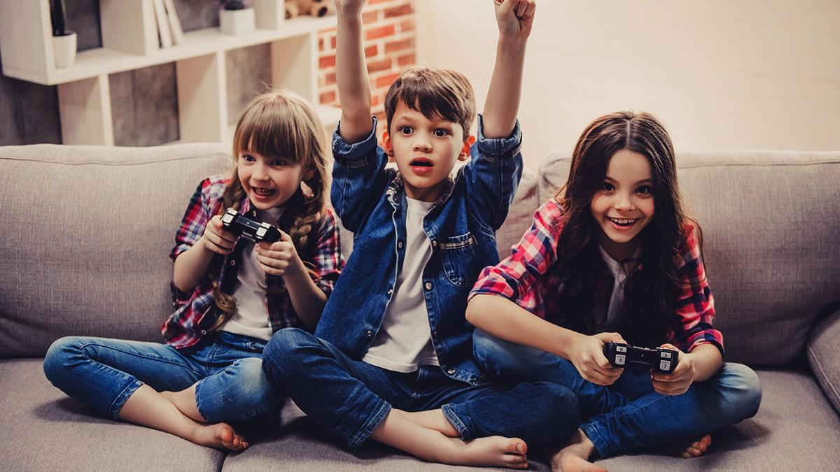
GROWING ENGAGEMENT
227M gamers in the US
76% of kids (under 18) play games
74% of parents play with their kids weekly
46% of gamers are female
Notes:
These are Mission Control specific numbers

Slide 5
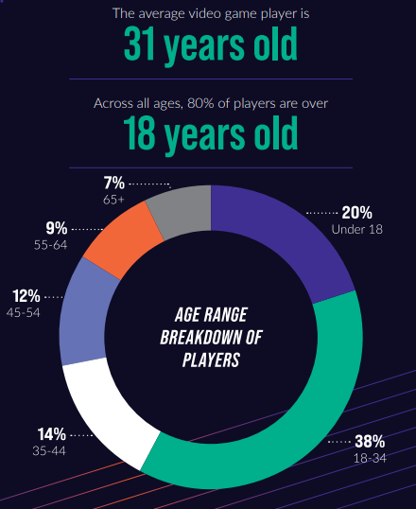
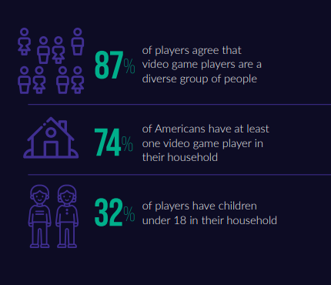
WHO IS PLAYING?
Notes:
Draw notes and talking points from here: http://www.differencebetween.net/miscellaneous/sports-miscellaneous/difference-between-esports-and-sports/
Use 214 million stat as tie in to next slide

Slide 6
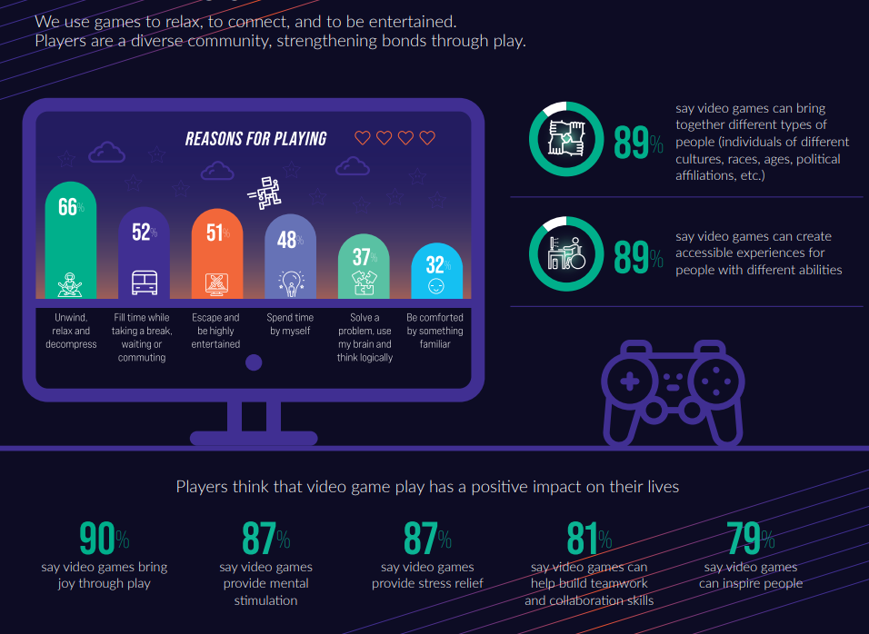
WHY ARE THEY PLAYING?
Notes:
Draw notes and talking points from here: http://www.differencebetween.net/miscellaneous/sports-miscellaneous/difference-between-esports-and-sports/
Use 214 million stat as tie in to next slide

Slide 7
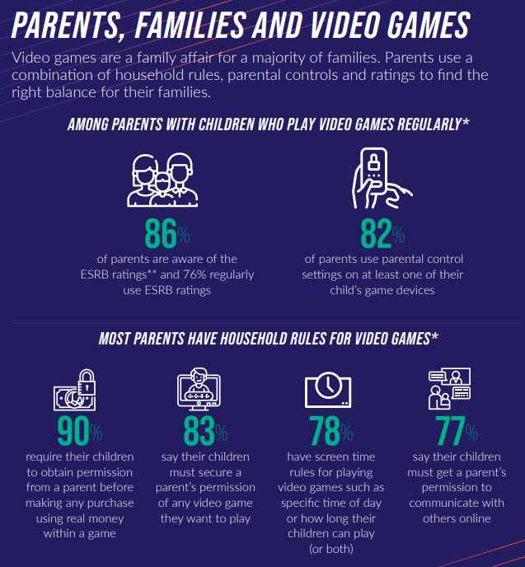
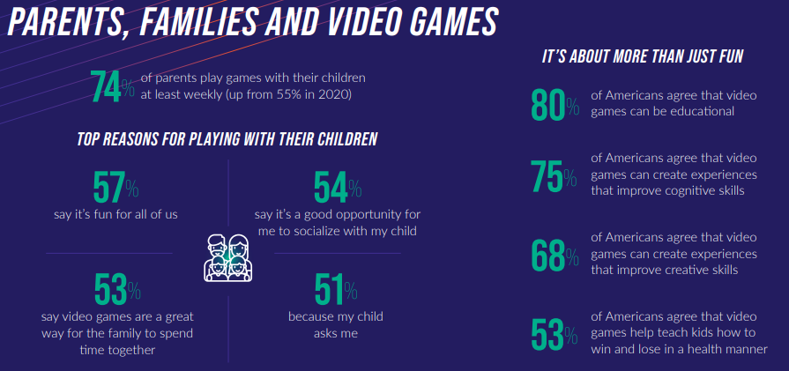
WHAT ABOUT THE PARENTS?
Notes:
Draw notes and talking points from here: http://www.differencebetween.net/miscellaneous/sports-miscellaneous/difference-between-esports-and-sports/
Use 214 million stat as tie in to next slide

Slide 8
The Opportunity in Recreation

Slide 9
TRADITIONAL SPORTS LANDSCAPE
PROFESSIONAL
AMATEUR
VARSITY
67.9 Million US Players
RECREATIONAL
$122B
-0.2%
Notes:
By comparison, 67 Million people in North America play team-based sports. I am also one of these people, playing organized rec league soccer as a way to spend time with friends on Thursday nights.
For traditional sports, this is where play started. It grew from local competition to higher levels of play.
And while the market is two/thirds the size by count of people, it commands an impressive $122B in sales across sports equipment and recreation centers in North America.
However, it’s stagnating. And esports is just getting started.

Slide 10
ESPORTS LANDSCAPE
PROFESSIONAL
AMATEUR
VARSITY
164 Million US Players
RECREATIONAL
$37B
$1.1B
9%
27%
Notes:
Esports grew in the same structure, but contrary to Traditional Sports, esports grew from the top down.
A ton of people play video games, but until recent technological improvements as well as shifting cultural norms, competition was reserved for the top. It’s started to move down, which has helped create a $37B video game market and $1.1B esports market.
The thing is, the players who can play at those top three levels only represent a tiny portion of the 103 Million North American social gamers. The rest of us are left to organize in the chaotic ways my friends I do as I showed you at the beginning.
The social gamer isn’t looking for something competitive and isn’t trying to win $1000 bucks by proving their the best. They want to be social, they want to spend time with friends doing something they love - not too far off me playing rec league soccer to spend time with my friends - just for esports, and it just needs to be organized.
Especially when you compare esports size to that of traditional sports, it is entirely evident that no one has quite yet figured out how to monetize this massive opportunity.
I worked in sports & esports venture capital before this, and we looked for companies that could fill this need.
The timing was perfect, but we couldn’t find a solution. So we left our jobs to build it.

Slide 11
ORGANIZATION VALUE PROPOSITION
AMENITY
REVENUE
DATA
Value added for current or future members
New revenue streams from untapped sources
Collection & analysis of actionable data
Notes:
Beyond being heroes, these organizations use our software because we deliver them value in at least one of three ways:
An amenity that acts as an engagement tool, for recruitment and retention tools (like Duke and SNHU)
A new revenue stream that can bring in capital from league registrations (like Dallas Parks & Rec or SportsMonster Adult Social Club)
As a data collection tool to learn more about their community (like MLSE and the Toronto fanbase)

Slide 12
PLAYER VALUE PROPOSITION
COMMUNITY
SOCIAL
STRUCTURE
Playing in a digital space now has an identity
Recreation creates a social experience driven by engagement not results
Players are looking for structure and organization
Notes:
Beyond being heroes, these organizations use our software because we deliver them value in at least one of three ways:
An amenity that acts as an engagement tool, for recruitment and retention tools (like Duke and SNHU)
A new revenue stream that can bring in capital from league registrations (like Dallas Parks & Rec or SportsMonster Adult Social Club)
As a data collection tool to learn more about their community (like MLSE and the Toronto fanbase)

Slide 13
BENEFITS OF PLAYING VIDEO GAMES
CRITICAL THINKING
TEAMWORK
CHARACTER
Players must rely on a range of cognitive abilities — problem-solving, memory recall, spatial awareness, and more
People learn, skills such as leadership, adaptability, and resourcefulness,which have countless applications in school and at work.
While playing video games, individuals learn how to solve problems, deal with successes and failures, and handle a range of emotions
Notes:
https://www.missioncontrol.gg/mission-control-blog-posts/why-video-games-arent-bad-for-you

Slide 14
PLAYER HIGHLIGHTS
87.8% engaged throughout the season
$21.39 average player registration fee for paid leagues
48.1% had not previously participated in rec sports
50%+ interacted with the app more than 3 times a week
Notes:
A lot of gaming has happened during our beta
13,000+ games
500+ leagues on Mission Control.
And the players love it.
88% are likely or greater to come back and play with Mission Control again
Orgs are reaching new people
48% of our players have never previously participated in rec sports at their organization before

Slide 15
KRPA Overview

Slide 16
Kansas Recreation Esports Championship
Deadline to Report Qualifying Players
Local Agency Qualifiers
State Championship
Aug 6th
Oct 7th
Oct 15th
Oct 18th
Nov 12th
1v1
1v1
1v1
2v2

Slide 17
Thank you!

